Slide 1
Hand Written Digit Recognition web app using MNIST Dataset

Slide 2
Introduction
Recognition is identifying or distinguishing a thing or an
individual from the past experiences or learning. Similarly,
Digit Recognition is nothing but recognizing or identifying the
digits in any document. Digit recognition framework is simply
the working of a machine to prepare itself or interpret the
digits. Handwritten Digit Recognition is the capacity of a
computer to interpret the manually written digits from various
sources like messages, bank cheques, papers, pictures, and so
forth and in various situations for web based handwriting
recognition on PC tablets, identifying number plates of
vehicles, handling bank cheques, digits entered in any forms
etc.

Slide 3
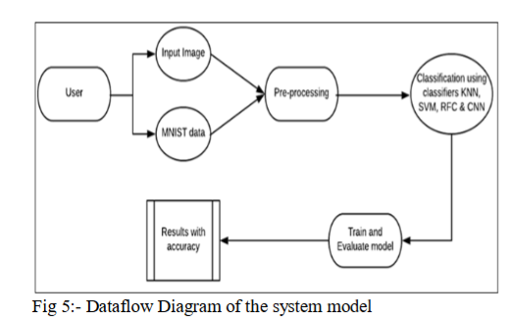
Architecture

Slide 4
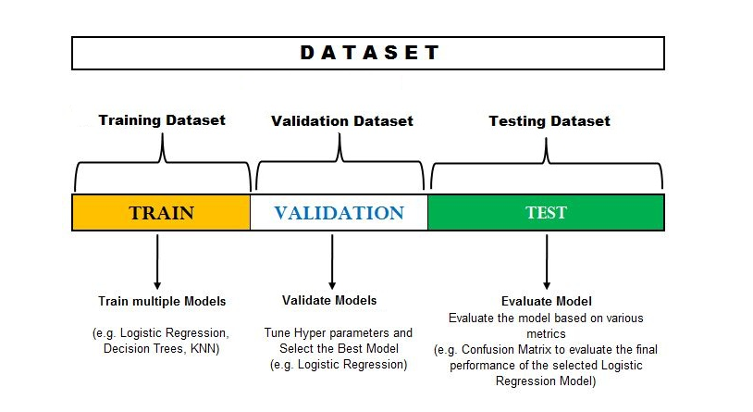
Dataset analysis

Slide 5
Pre - processing
The role of the pre-processing step is it performs various
tasks on the input image. It basically upgrades the image by
making it reasonable for segmentation. The fundamental
motivation behind pre-processing is to take off a fascinating
example from the background. For the most part, noise
filtering, smoothing and standardization are to be done in this
stage. The pre-processing additionally characterizes a smaller
portrayal of the example. Binarization changes over a gray
scale image into a binary image.
The initial approach to the training set images that are to
be processed in order to reduce the data, by thresholding them
into a binary image. The Figure above shows a sample of images
taken from the MNIST database.

Slide 6
Segmentation:
Once the pre-processing of the input images is
completed, sub-images of individual digits are formed from
the sequence of images. Pre-processed digit images are
segmented into a sub-image of individual digits, which are
assigned a number to each digit. Each individual digit is
resized into pixels. In this step an edge detection technique is
being used for segmentation of dataset images.
Feature Extraction:
After the completion of pre-processing stage and
segmentation stage, the pre-processed images are represented
in the form of a matrix which contains pixels of the images
that are of very large size. In this way it will be valuable to
represent the digits in the images which contain the necessary
information. This activity is called feature extraction. In the
feature extraction stage redundancy from the data is removed.

Slide 7
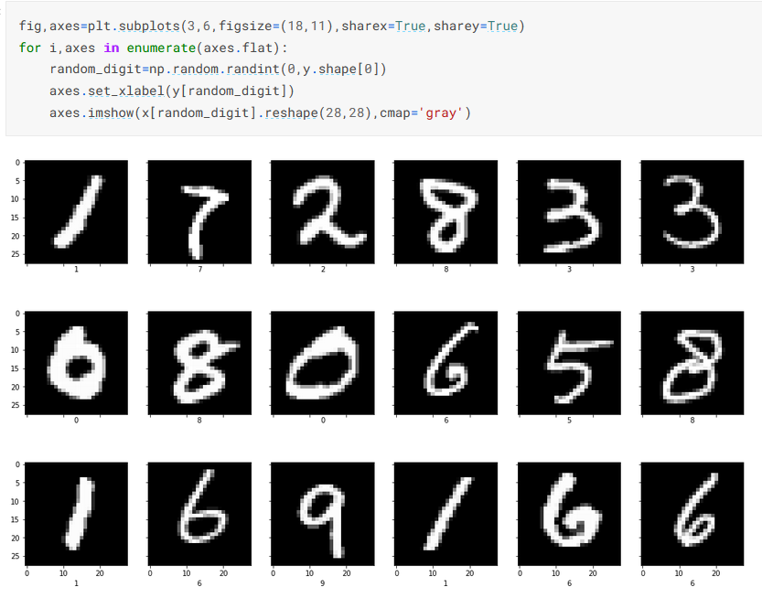
Classification and Recognition:
In the classification and recognition step the extracted
feature vectors are taken as an individual input to each of the
following classifiers. In order to showcase the working system
model extracted features are combined and defined using f ollowing three classifiers:
• K-Nearest Neighbor
• Random Forest Classifier
• Support Vector Machine

Slide 8
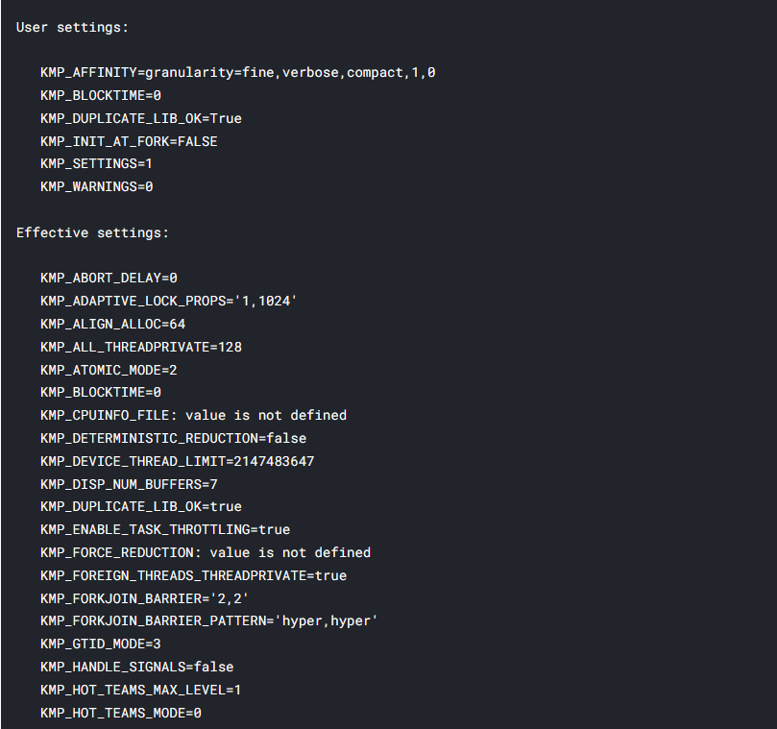
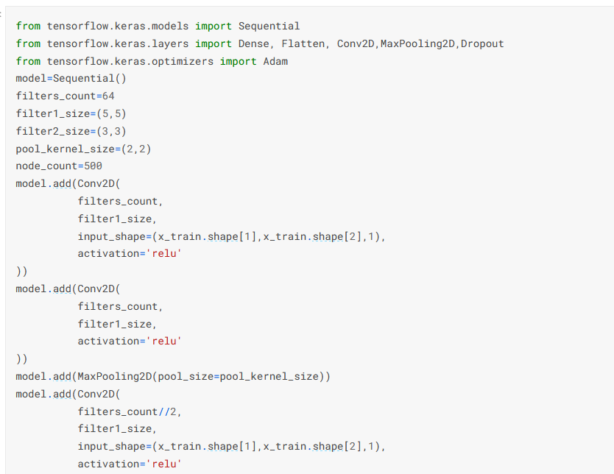
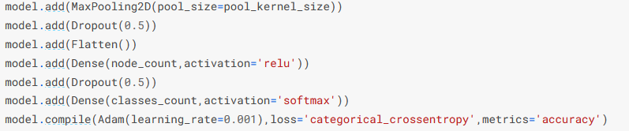
CNN model

Slide 9
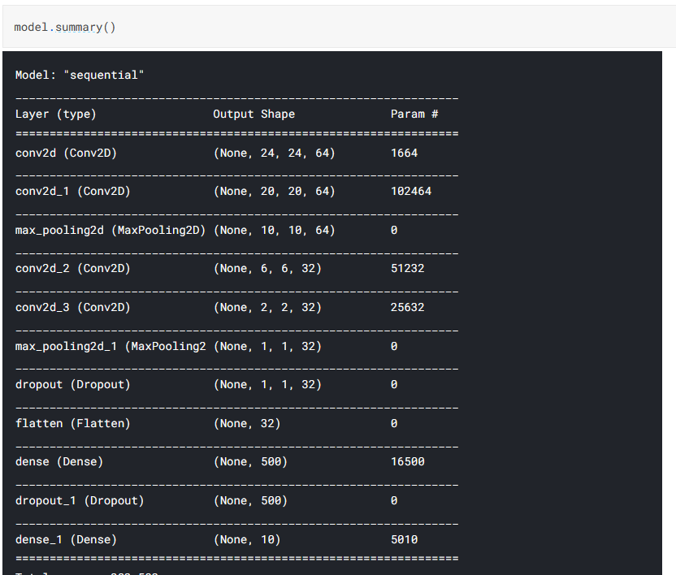

Slide 10
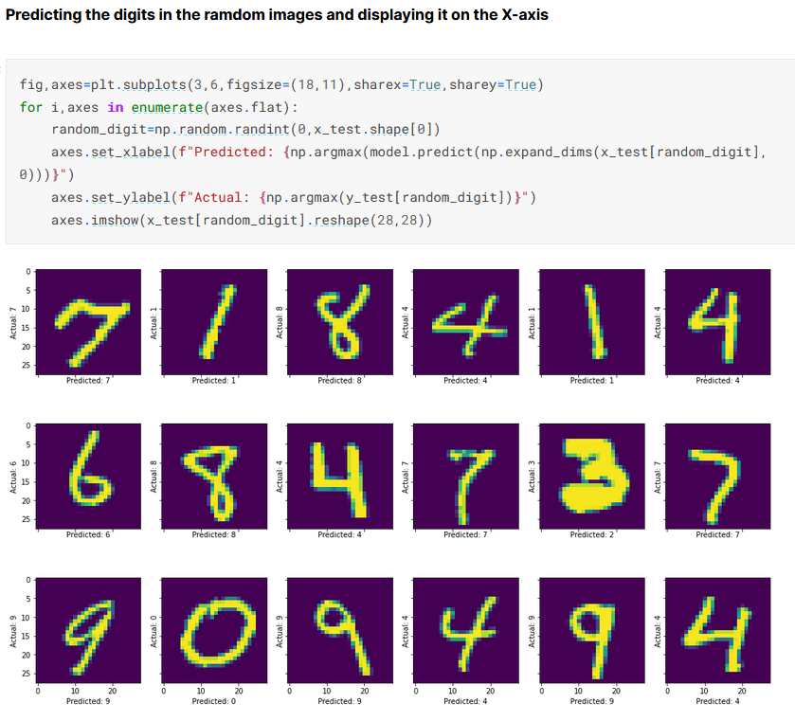
Output

Slide 11
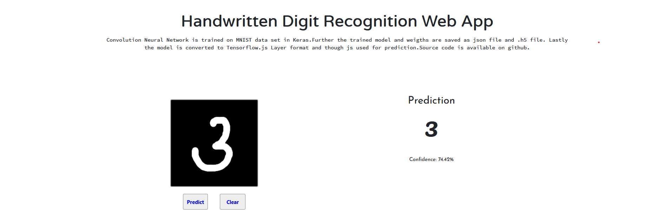
GUI prototype

